Slide 1
Introduction to Data Science
Lab 1

Slide 2
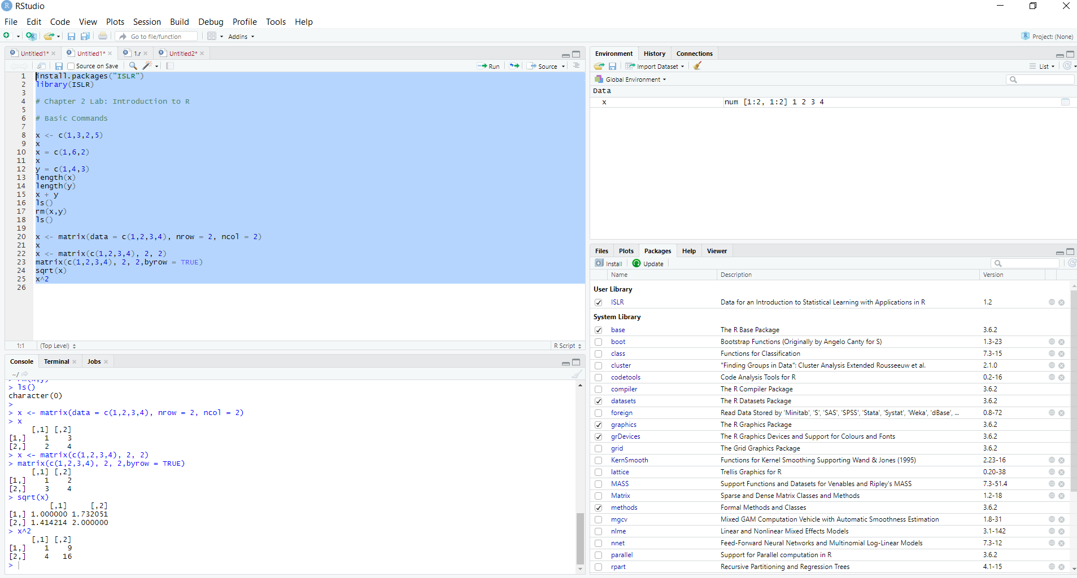
Chapter 2 Lab: Introduction to R Basic Commands

Slide 3
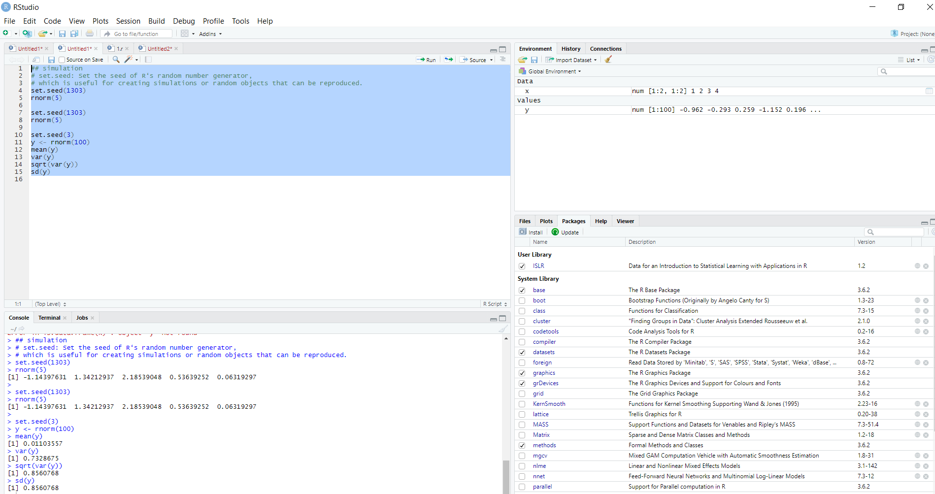
Simulation

Slide 4
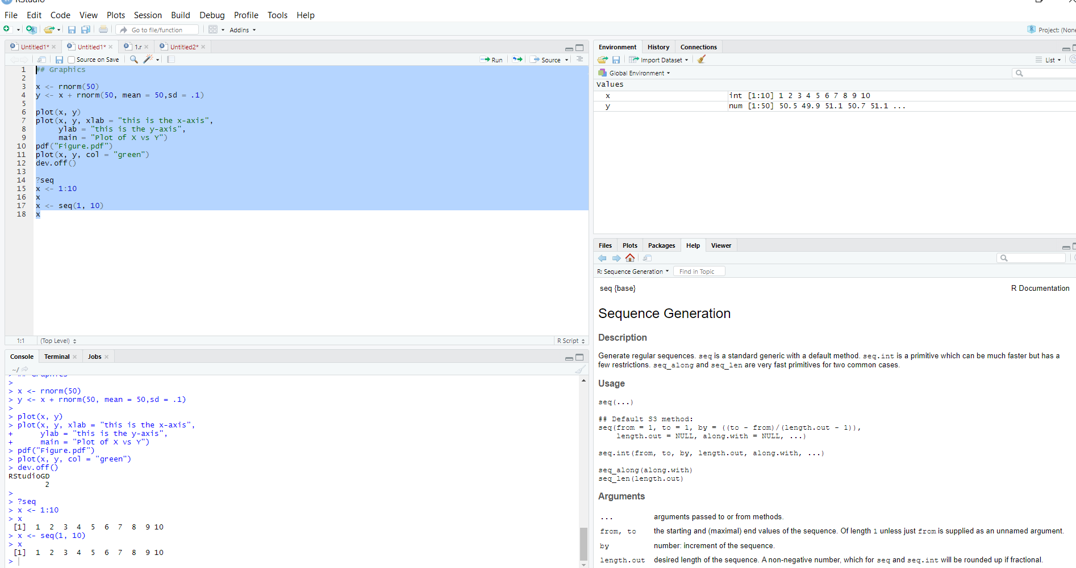
Graphics

Slide 5
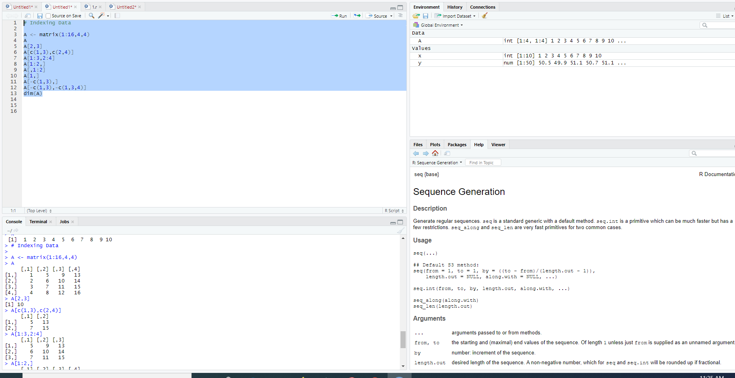
Indexing Data

Slide 6
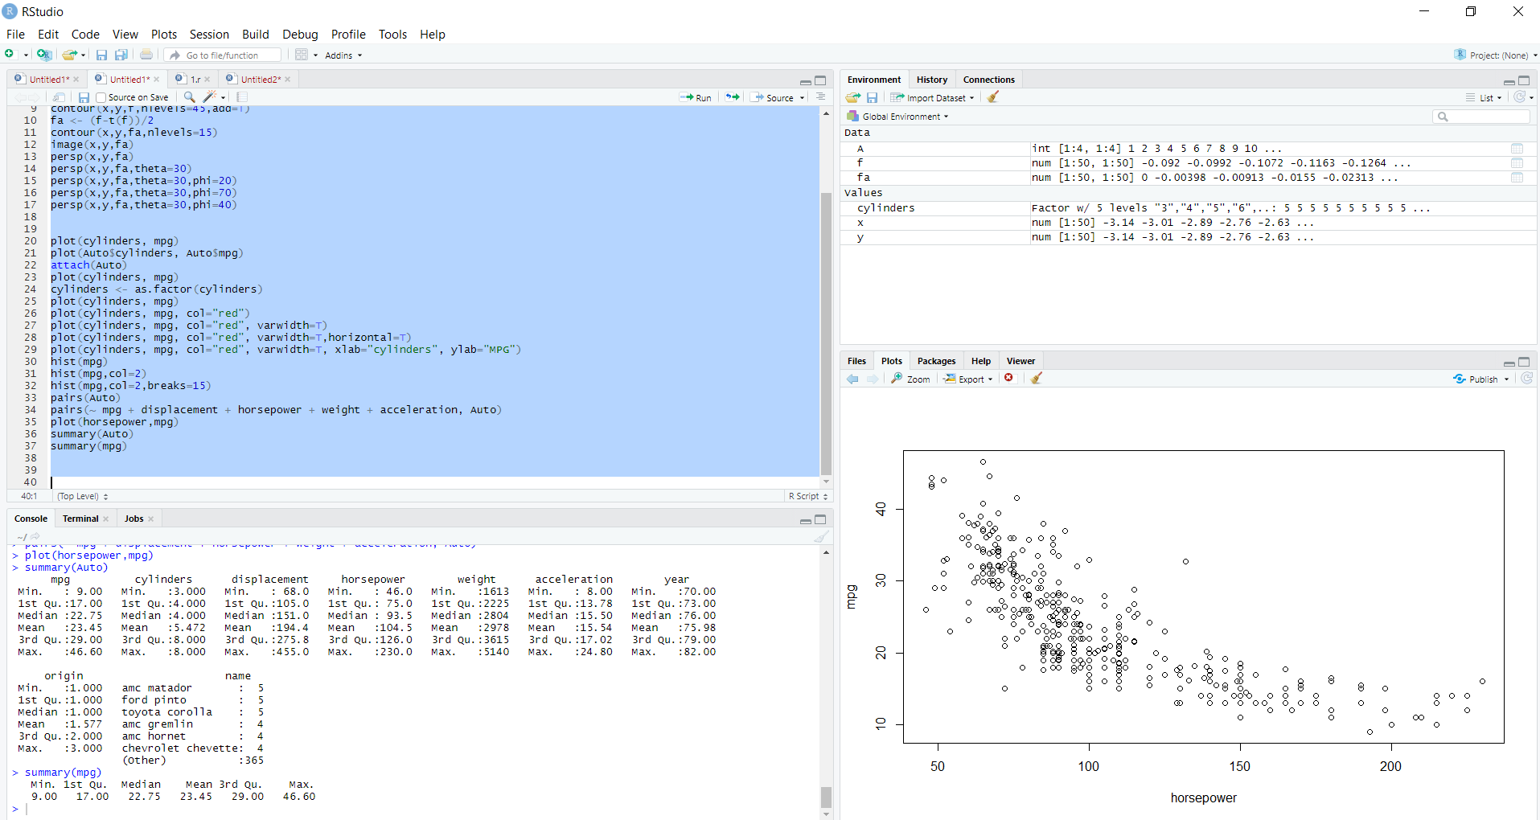
Additional Graphical and Numerical Summaries

